Slide 1
Module 2
Symmetric and Asymmetric key Cryptography and key management

Slide 2
Symmetric ciphers
Stream ciphers
Block ciphers

Slide 3
Block Ciphers
A block cipher operates on a plaintext block of n bits to produce a ciphertext of n bits.
There are 2n possible different plaintext blocks
For the encryption to be reversible, each plaintext block must produce a unique ciphertext block
However, if the block size is too small (e.g. n = 4), then the cipher is equivalent to a classical substitution cipher.

Slide 4
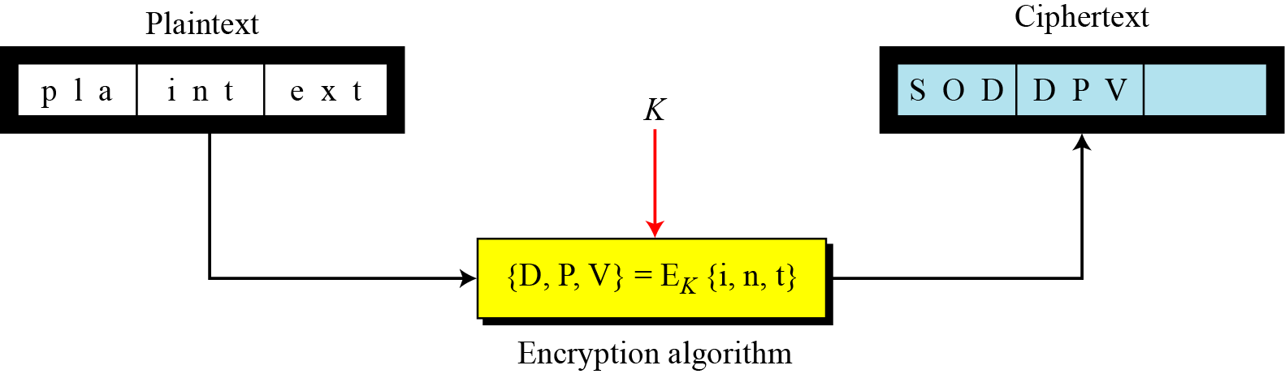
In a block cipher, a group of plaintext symbols of size m (m > 1) are encrypted together creating a group of ciphertext of the same size.
A single key is used to encrypt the whole block

Slide 5
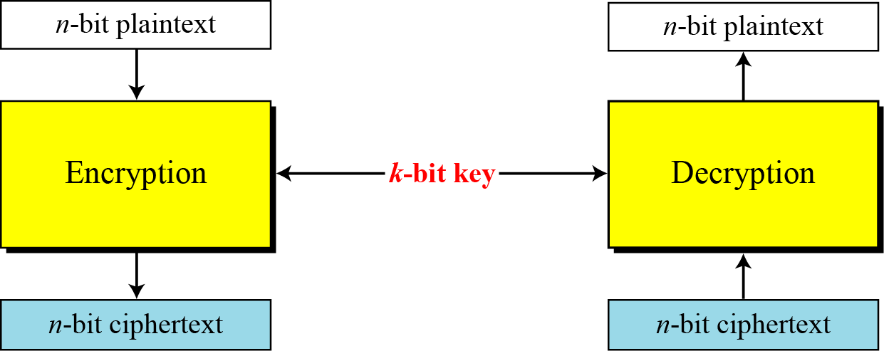
A symmetric-key modern block cipher encrypts an n-bit block of plaintext or decrypts an n-bit block of ciphertext. The encryption or decryption algorithm uses a k-bit key.

Slide 6
If the message has fewer than n bits, padding must be added to make it an n-bit block.
If the message has more than n bits, it should be divided into n-bit blocks and the appropriate padding must be added to the last block if necessary.
The common values for n are 64, 128, 256, or 512 bits.

Slide 7
Substitution or Transposition
A modern block cipher can be designed to act as a substitution cipher or a transposition cipher.
This is the same idea as is used in traditional ciphers, except that the symbols to be substituted or transposed are bits instead of characters.
Modern block ciphers are designed as substitution ciphers because the inherent characteristics of transposition (preserving the number of 1’s or 0’s) makes the cipher vulnerable to exhaustive-search attacks, as the next example shows.

Slide 8
Que: Suppose that we have a block cipher where n = 64. If there are 10 1’s in the ciphertext, how many trial-and-error tests does Eve need to do to recover the plaintext from the intercepted ciphertext in each of the following cases?
a. The cipher is designed as a substitution cipher.
b. The cipher is designed as a transposition cipher.
In the first case, Eve has no idea how many 1’s are in the plaintext. Eve needs to try all possible 2⁶⁴ 64-bit blocks to find one that makes sense.
In the second case, Eve knows that there are exactly 10 1’s in the plaintext. Eve can launch an exhaustive-search attack using only those 64-bit blocks that have exactly 10 1’s.
5.8

Slide 9
Block Ciphers as Permutation Groups
Full-Size Key Transposition Block Ciphers
In a full-size key transposition cipher We need to have n! possible keys, so the key should have ⎡log₂ n!⎤ bits.
EX. Show the model and the set of permutation tables for a 3-bit block transposition cipher where the block size is 3 bits.
Solution
The set of permutation tables has 3! = 6 elements, as shown in Figure below.
5.9

Slide 10
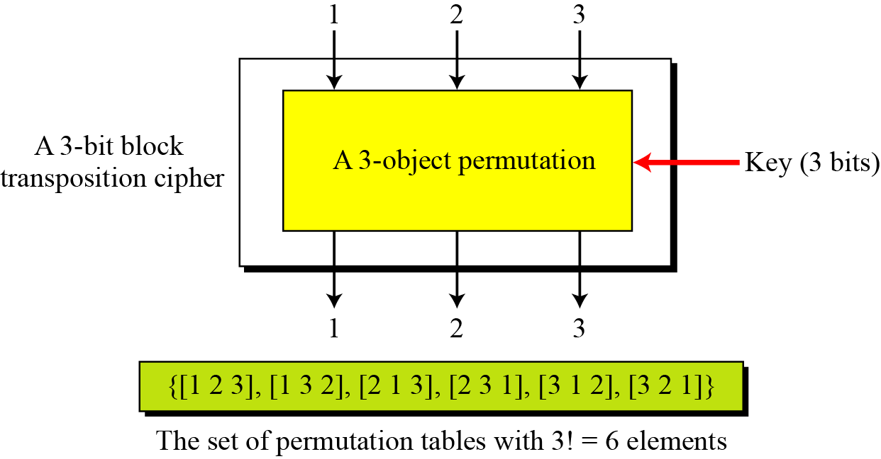
A transposition block cipher modeled as a permutation
5.10

Slide 11
Full-Size Key Substitution Block Ciphers
A full-size key substitution cipher does not transpose bits; it substitutes bits. We can model the substitution cipher as a permutation if we can decode the input and encode the output.
Show the model and the set of permutation tables for a 3-bit block substitution cipher.
Solution
Figure below shows the model and the set of permutation tables. The key is also much longer, [log₂40,320] = 16 bits.
5.11

Slide 12
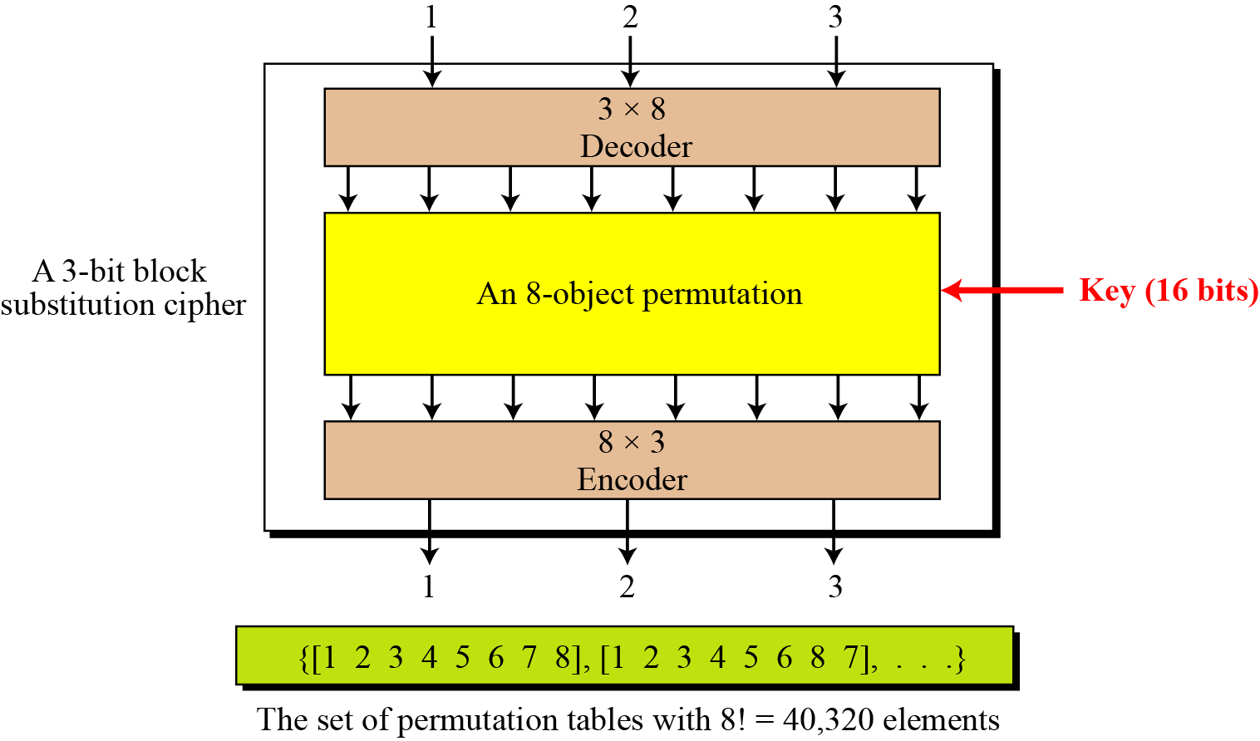
A substitution block cipher model as a permutation
5.12

Slide 13
A full-size key n-bit transposition cipher or a substitution block cipher can be modeled
as a permutation, but their key sizes are different:
Transposition: the key is [log₂n!] bits long.
Substitution: the key is [log₂(2^{n})!] bits long.
A partial-key cipher is a group under the composition operation if it is a subgroup
of the corresponding full-size key cipher.
5.13

Slide 14
Components of a Modern Block Cipher
Modern block ciphers normally are keyed substitution ciphers in which the key allows only partial mappings from the possible inputs to the possible outputs.
P-Boxes
A P-box (permutation box) parallels the traditional transposition cipher for characters. It transposes bits.
5.14

Slide 15
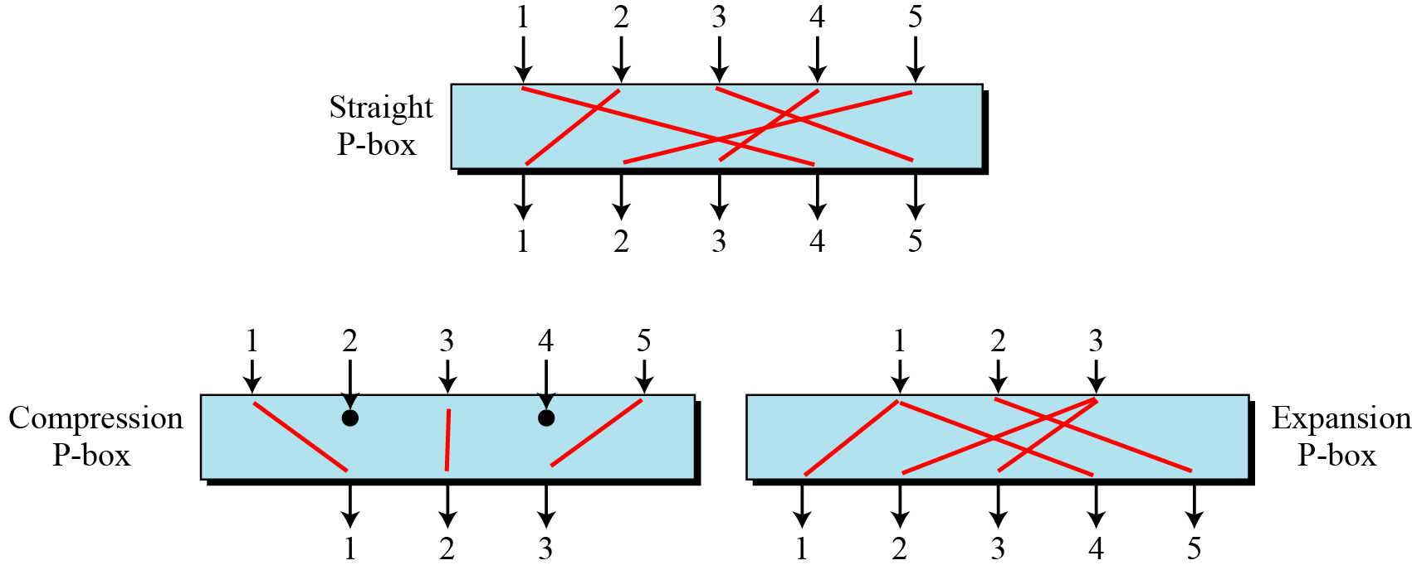
Three types of P-boxes
5.15

Slide 16
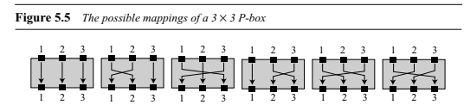
Straight P-Boxes A straight P-Box with n inputs and n outputs is a permutation.
There are n! possible mappings.

Slide 17
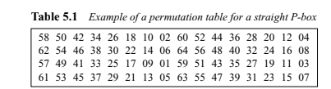
For n=64

Slide 18
A compression P-box is a P-box with n inputs and m outputs
where m < n. Some of the inputs are blocked and do not reach the output (see Figure in previous slide).
The compression P-boxes used in modern block ciphers normally are keyless with a permutation table showing the rule for transposing bits.
We need to know that a permutation table for a compression P-box has m entries, but the content of each entry is from 1 to n with some missing values (those inputs that are blocked).
Compression P-boxes are used when we need to permute bits and the same time decrease the number of bits for the next stage.

Slide 19
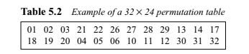
For n=32, m=24

Slide 20
An expansion P-box is a P-box with n inputs and m outputs where m > n. Some of the inputs are connected to more than one input (see Figure in previous slide).
The expansion P-boxes used in modern block ciphers normally are keyless, where a permutation table shows the rule for transposing bits. We need to know that a permutation table for an expansion P-box has m entries, but m − n of the entries are repeated (those inputs mapped to more than one output).
Expansion P-boxes are used when we need to permute bits and the same time
increase the number of bits for the next stage.

Slide 21
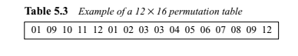
For n=12, m=16

Slide 22
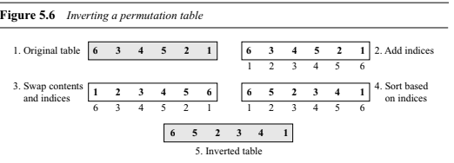
Invertibility: A straight P-box is invertible. This means that we can use a straight P-box in the encryption cipher and its inverse in the decryption cipher. The permutation tables, however, need to be the inverses of each other. A straight P-box is invertible, but compression and expansion P-boxes are not.

Slide 23
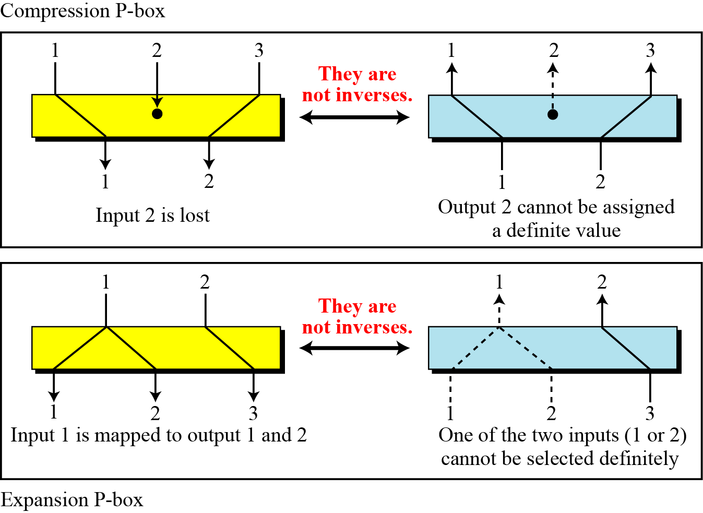
Compression and expansion P-boxes are non-invertible
5.23

Slide 24
S-Boxes
An S-box (substitution box) can be thought of as a miniature substitution cipher. However, an S-box can have a different number of inputs and outputs.
In other words, the input to an S-box could be an n-bit word, but the output can be an m-bit word, where m and n are not necessarily the same.
Although an S-box can be keyed or keyless, modern block ciphers normally use keyless S-boxes, where the mapping from the inputs to the outputs is predetermined.
An S-box is an m × n substitution unit, where m and n are not necessarily the same.

Slide 25
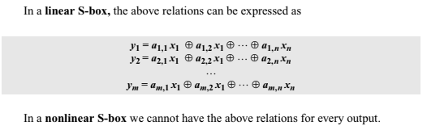

Slide 26
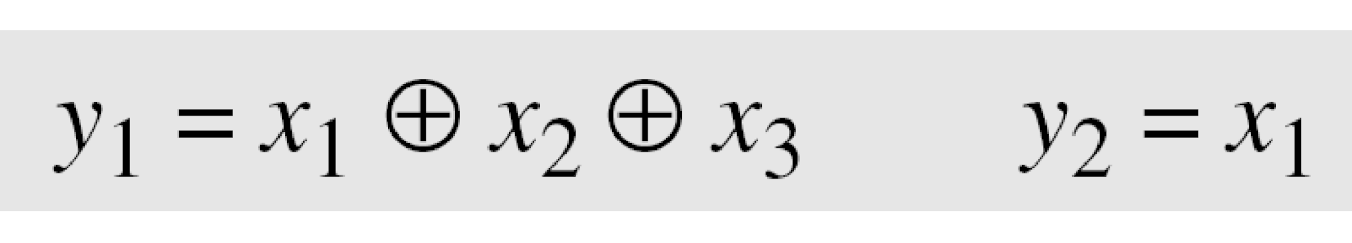
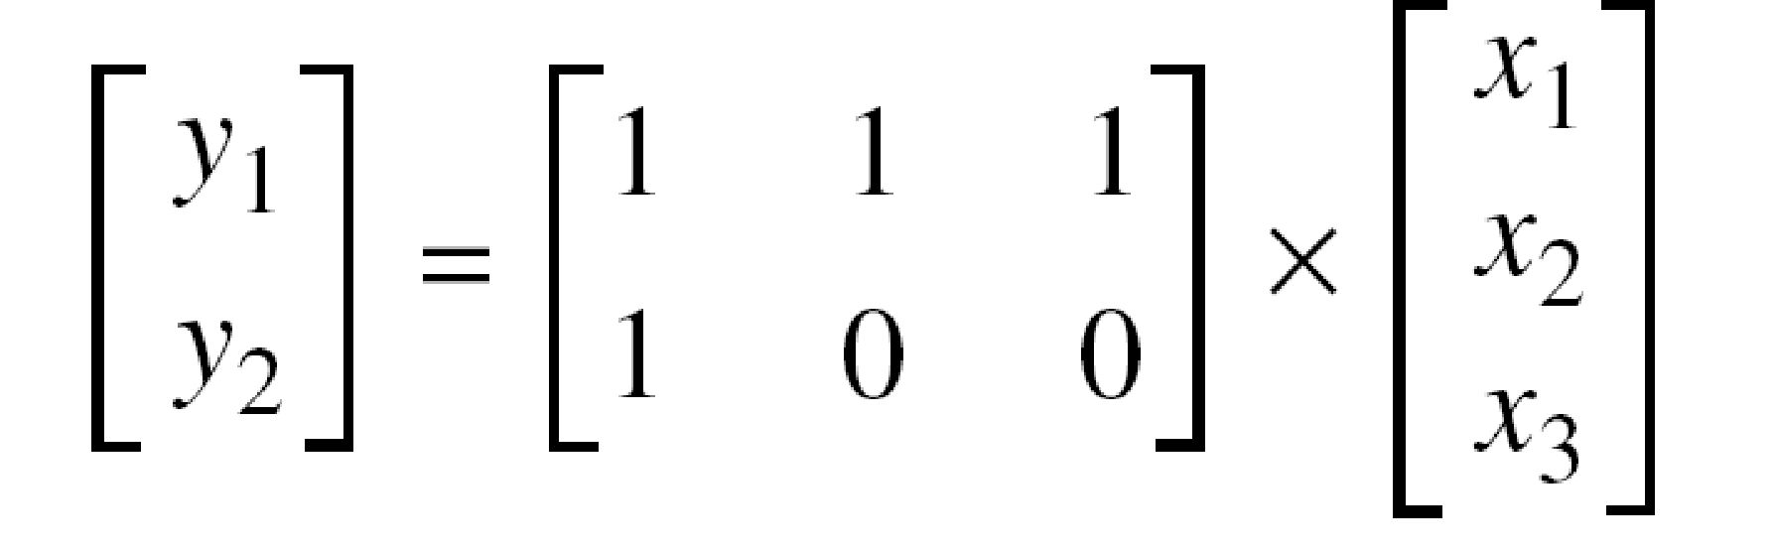
Example
In an S-box with three inputs and two outputs, we have
The S-box is linear because a_{1,1} = a_{1,2} = a_{1,3} = a_{2,1} = 1 and a_{2,2} = a_{2,3} = 0. The relationship can be represented by matrices, as shown below:
5.26

Slide 27
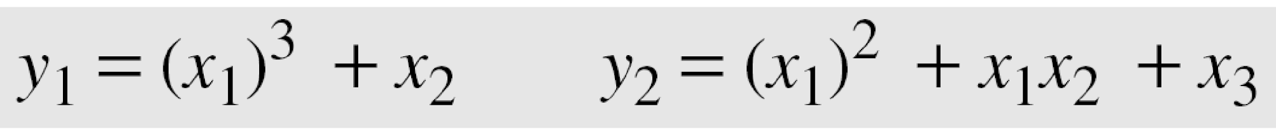
Example
In an S-box with three inputs and two outputs, we have
where multiplication and addition is in GF(2). The S-box is nonlinear because there is no linear relationship between the inputs and the outputs.
5.27

Slide 28
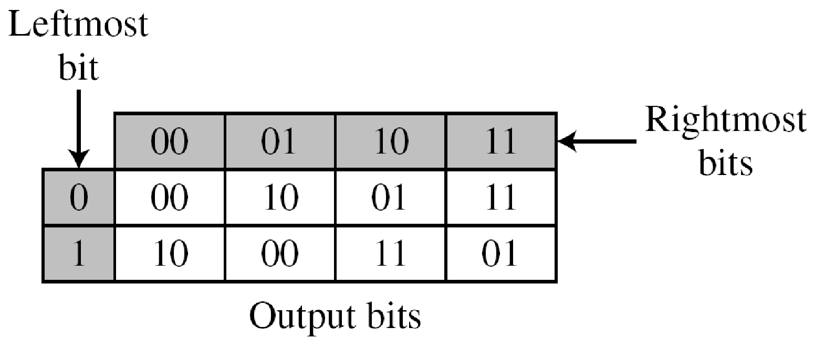
Example
The following table defines the input/output relationship for an S-box of size 3 × 2. The leftmost bit of the input defines the row; the two rightmost bits of the input define the column. The two output bits are values on the cross section of the selected row and column.
Based on the table, an input of 010 yields the output 01. An input of 101 yields the output of 00.
5.28

Slide 29
S-Boxes: Invertibility
An S-box may or may not be invertible. In an invertible S-box, the number of input bits should be the same as the number of output bits.
5.29

Slide 30
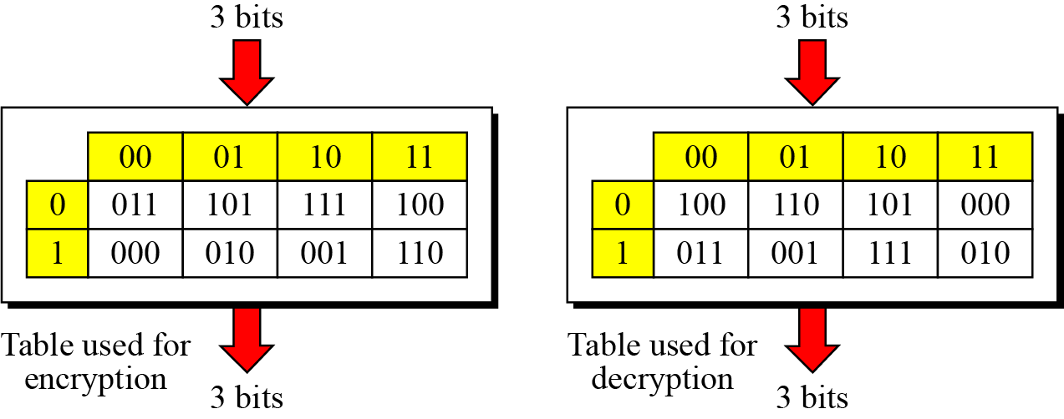
Example
Figure below shows an example of an invertible S-box. For example, if the input to the left box is 001, the output is 101. The input 101 in the right table creates the output 001, which shows that the two tables are inverses of each other.
S-box tables for given Example
5.30

Slide 31
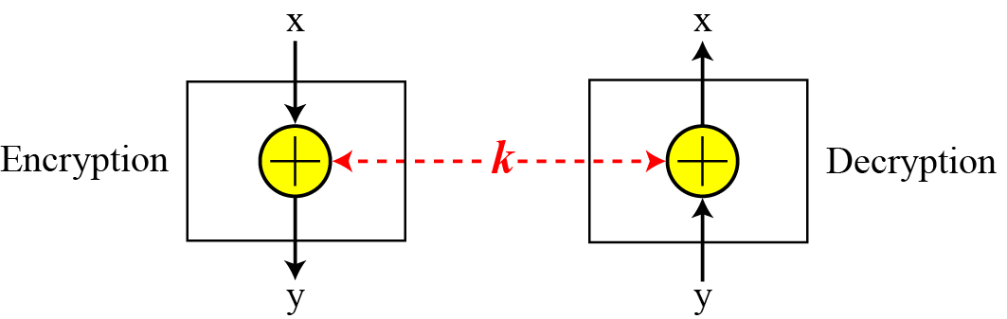
Exclusive-Or
An important component in most block ciphers is the exclusive-or operation.
Invertibility of the exclusive-or operation
5.31

Slide 32
An important component in most block ciphers is the exclusive-or operation. Addition and subtraction operations in the GF(2^{n}) field are performed by a single operation called the exclusive-or (XOR).
The five properties of the exclusive-or operation in the GF(2n) field makes this operation a very interesting component for use in a block cipher: closure, associativity, commutativity, existence of identity, and existence of inverse.
5.32

Slide 33
Circular Shift
Another component found in some modern block ciphers is the circular shift operation. Shifting can be to the left or to the right.
The circular left-shift operation shifts each bit in an n-bit word k positions to the left; the leftmost k bits are removed from the left and become the rightmost bits.
The circular right-shift operation shifts each bit in an n-bit word k positions to the right; the rightmost k bits are removed from the right and become the leftmost bits. Figure shows both left and right operations in the case where n = 8 and k = 3.
The circular shift operation mixes the bits in a word and helps hide the patterns in the original word.
Although the number of positions to be shifted can be used as a key, the circular shift operation normally is keyless; the value of k is fixed and predetermined.

Slide 34
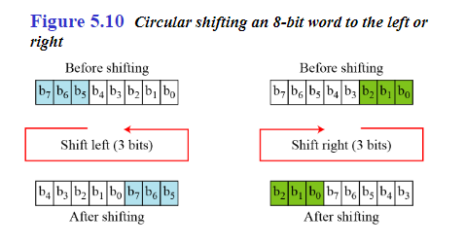

Slide 35
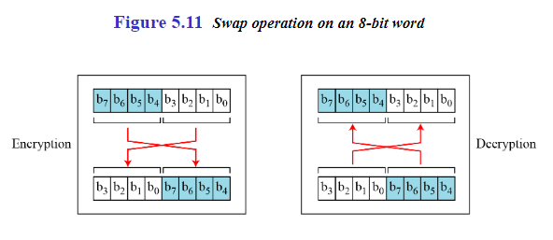
Swap
The swap operation is a special case of the circular shift operation where k = n/2. This means this operation is valid only if n is an even number. Because left-shifting n/2 bits is the same as right-shifting n/2, this component is self-invertible. A swap operation in the encryption cipher can be totally canceled by a swap operation in the decryption cipher.

Slide 36
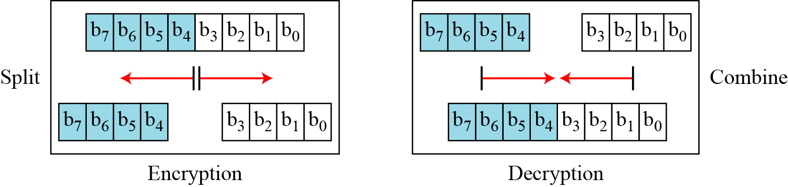
Split and Combine
Two other operations found in some block ciphers are split and combine.
Split and combine operations on an 8-bit word
5.36

Slide 37
Product Ciphers
Shannon introduced the concept of a product cipher. A product cipher is a complex cipher combining substitution, permutation, and other components discussed in previous sections.
5.37

Slide 38
Confusion and Diffusion
Diffusion : to hide the relationship between the cipher text and the plain text.
Diffusion implies that each symbol in the ciphertext is dependent on some or all symbols in the plain text.
This will frustrate the opponent who use cipher text statistics to find the plain text.
Confusion: to hide the relationship between the cipher text and the key.
If a single bit in the key is changed most or all bits in the cipher text will also be changed.
This will frustrate the opponent who use cipher text statistics to find the key

Slide 39
Rounds
Diffusion and confusion can be achieved using iterated product ciphers where each iteration is a combination of S-boxes, P-boxes, and other components.
5.39

Slide 40
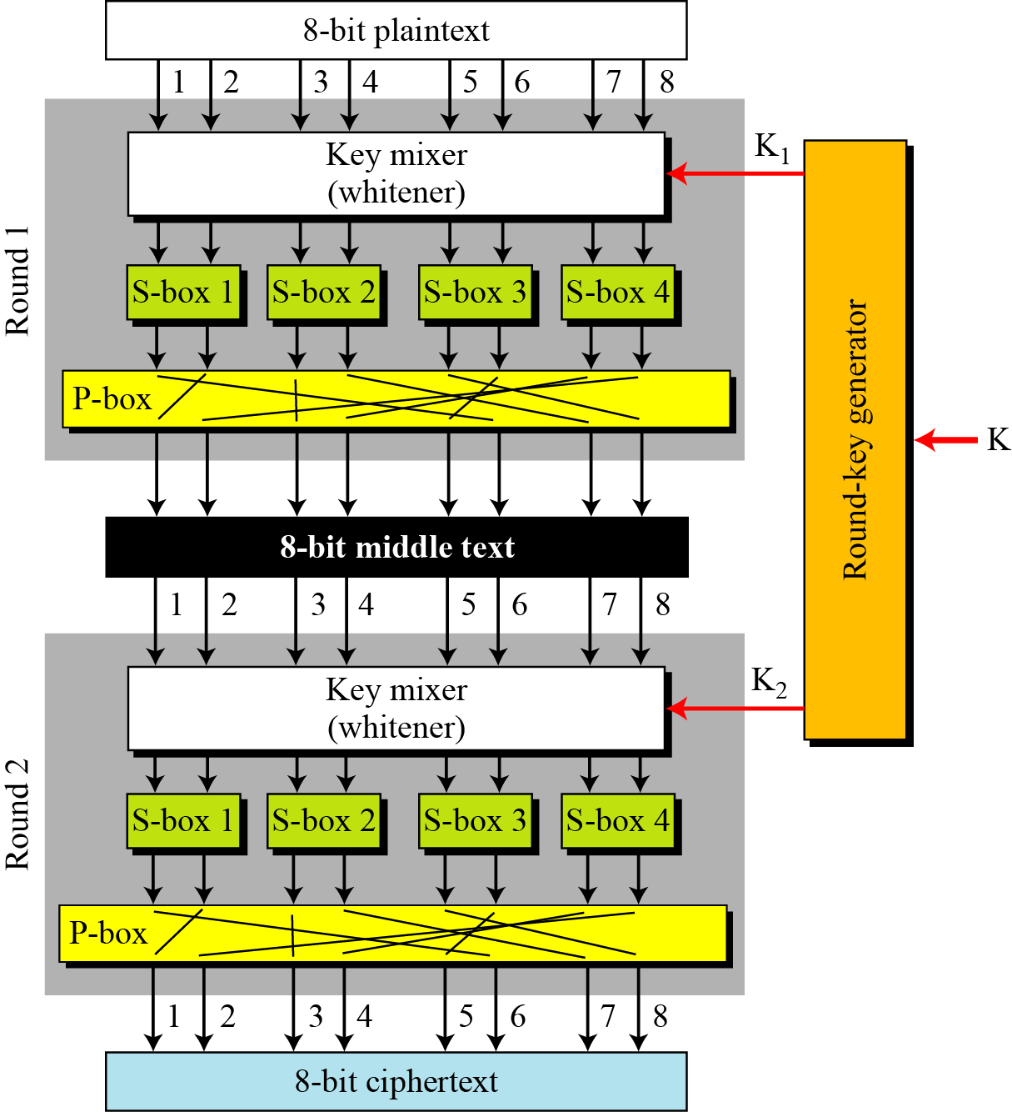
A product cipher made of two rounds
5.40

Slide 41
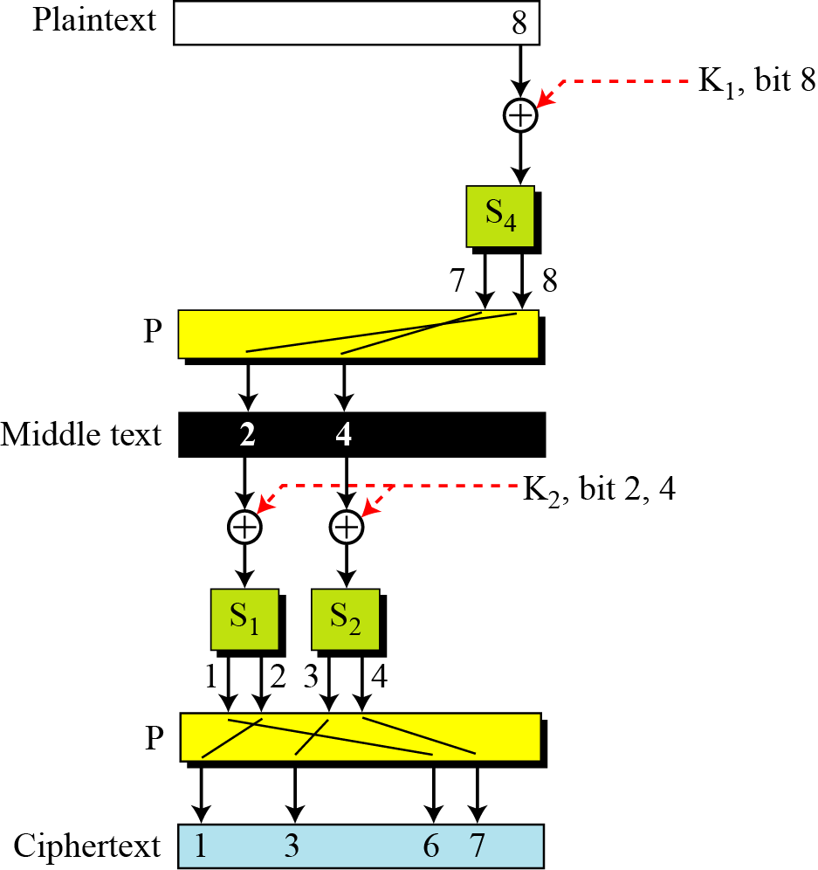
Diffusion and confusion in a block cipher
5.41

Slide 42
Two Classes of Product Ciphers
Modern block ciphers are all product ciphers, but they are divided into two classes.
1. Feistel ciphers
2. Non-Feistel ciphers
5.42

Slide 43
Feistel Ciphers
Feistel designed a very intelligent and interesting cipher that has been used for decades. A Feistel cipher can have three types of components: self-invertible, invertible, and
noninvertible.
5.43

Slide 44
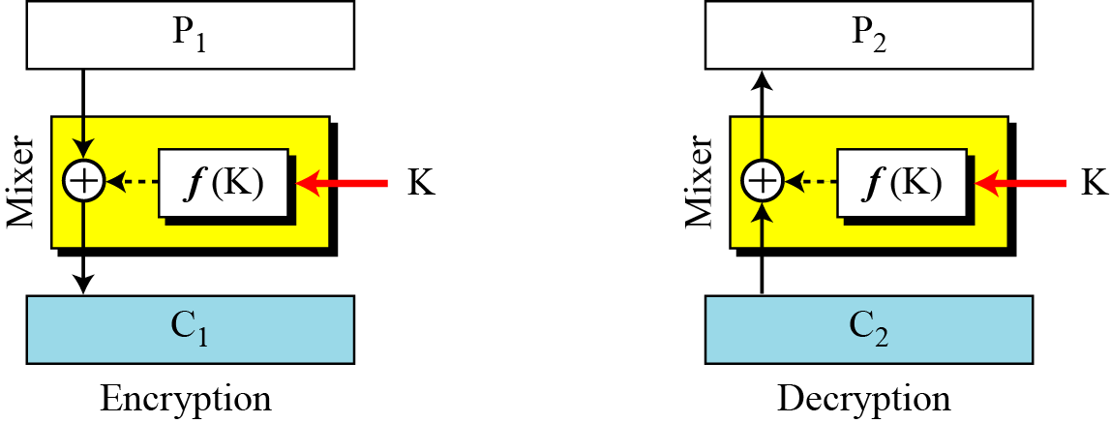
The first thought in Feistel cipher design
Diffusion hides the relationship between the ciphertext and the plaintext.
5.44

Slide 45
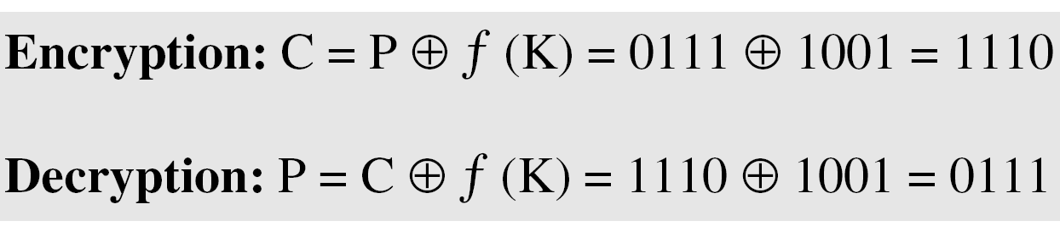
Example
The plaintext and ciphertext are each 4 bits long and the key is 3 bits long. Assume that the function takes the first and third bits of the key, interprets these two bits as a decimal number, squares the number, and interprets the result as a 4-bit binary pattern. Show the results of encryption and decryption if the original plaintext is 0111 and the key is 101.
Solution
The function extracts the first and second bits to get 11 in binary or 3 in decimal. The result of squaring is 9, which is 1001 in binary.
5.45

Slide 46
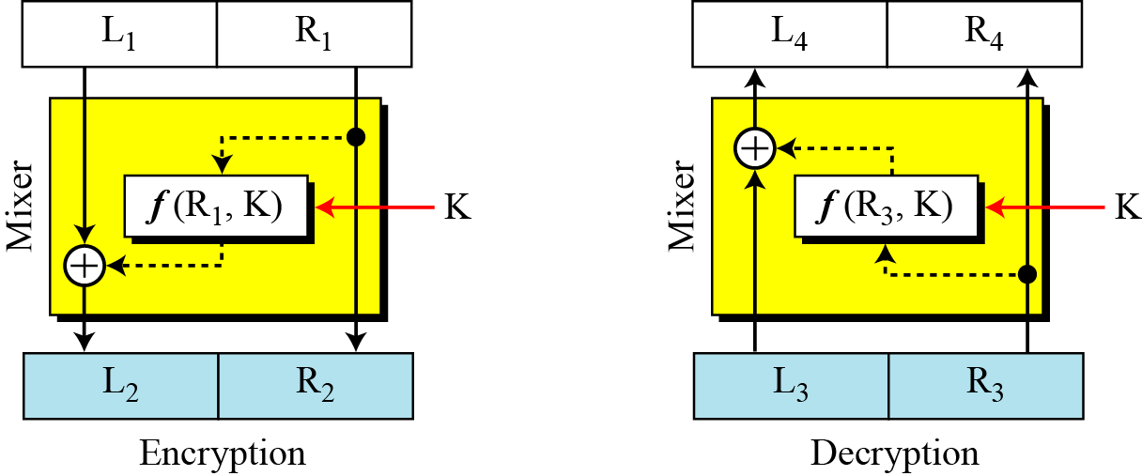
Improvement of the previous Feistel design
5.46

Slide 47
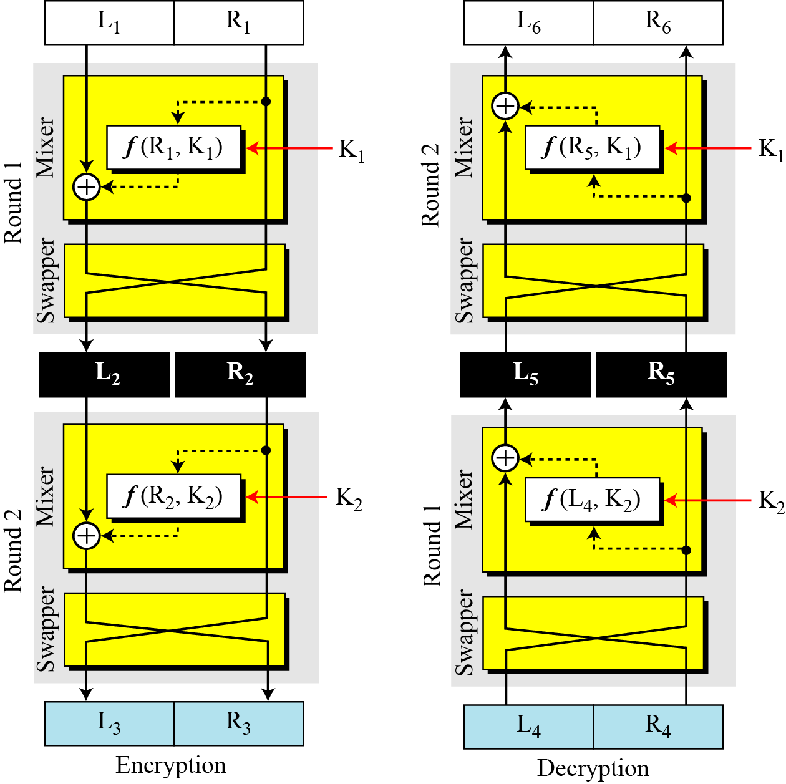
Final design of a Feistel cipher with two rounds
5.47

Slide 48
Non-Feistel Ciphers
A non-Feistel cipher uses only invertible components. A component in the encryption cipher has the corresponding component in the decryption cipher.
5.48

Slide 49
Attacks on Block Ciphers
Attacks on traditional ciphers can also be used on modern block ciphers, but today’s block ciphers resist most of the attacks.
5.49

Slide 50
Differential Cryptanalysis
Eli Biham and Adi Shamir introduced the idea of differential cryptanalysis. This is a chosen-plaintext attack.
Differential cryptanalysis is based on a nonuniform differential distribution table of the S-boxes in a block cipher.
5.50

Slide 51
Linear Cryptanalysis
Linear cryptanalysis was presented by Mitsuru Matsui in 1993. The analysis uses known plaintext attacks.
5.51

Slide 52
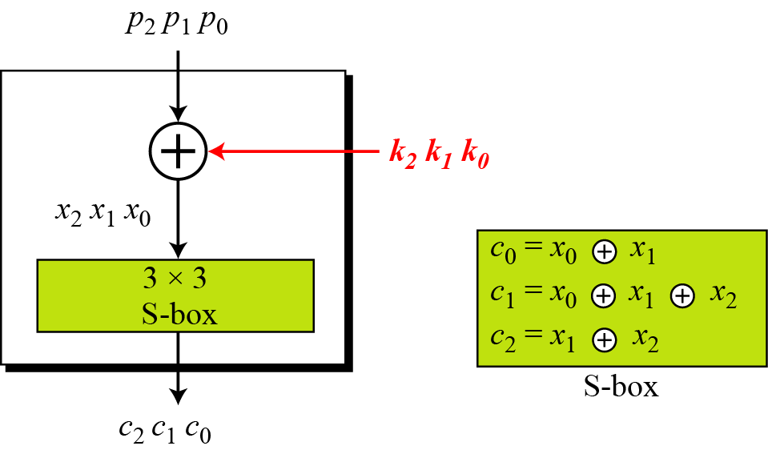
A simple cipher with a linear S-box
5.52

Slide 53
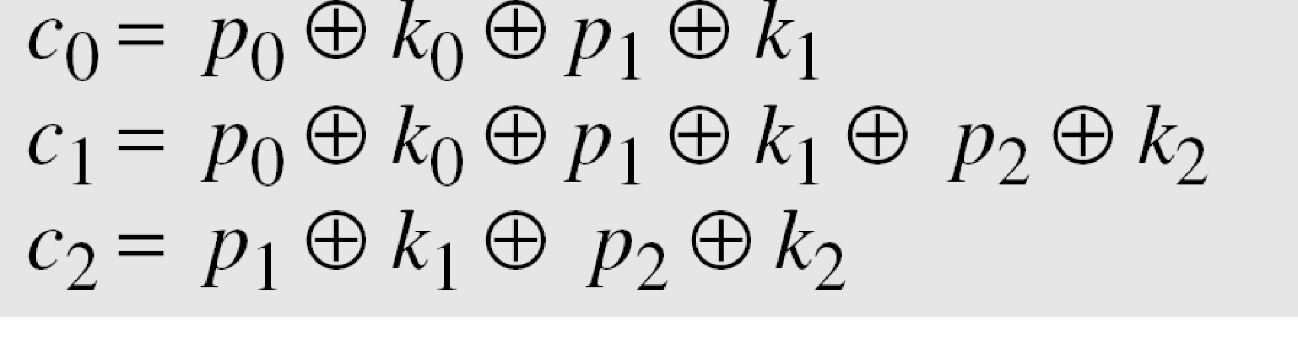
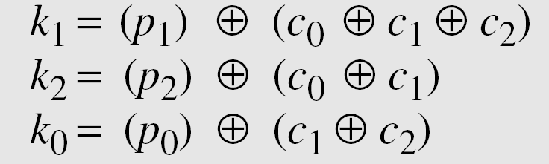
Solving for three unknowns, we get.
This means that three known-plaintext attacks can find the values of k₀, k₁, and k₂ .
5.53

Slide 54
5-2 MODERN STREAM CIPHERS
In a modern stream cipher, encryption and decryption
are done r bits at a time. We have a plaintext bit stream P = p_{n}…p₂ p₁, a ciphertext bit stream C = c_{n}…c₂ c₁, and a key bit stream K = k_{n}…k₂ k₁, in which p_{i} , c_{i} , and k_{i} are r-bit words.
Synchronous Stream Ciphers
Nonsynchronous Stream Ciphers
5.54

Slide 55
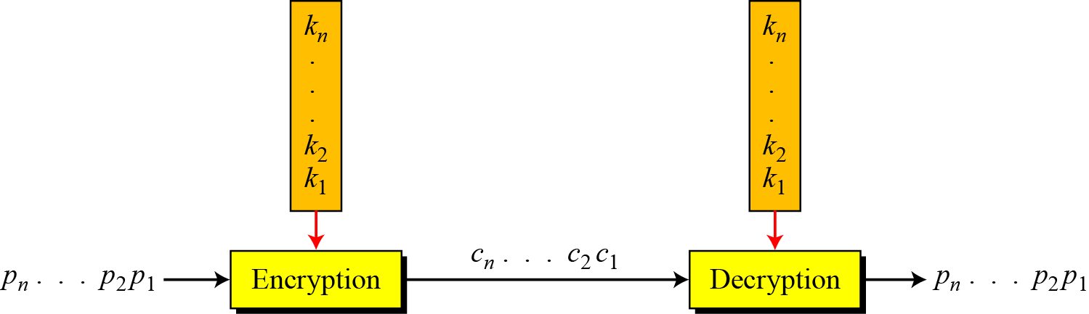
Stream cipher
In a modern stream cipher, each r-bit word in the plaintext stream is enciphered using an r-bit word in the key stream to create the corresponding r-bit
word in the ciphertext stream.
5.55

Slide 56
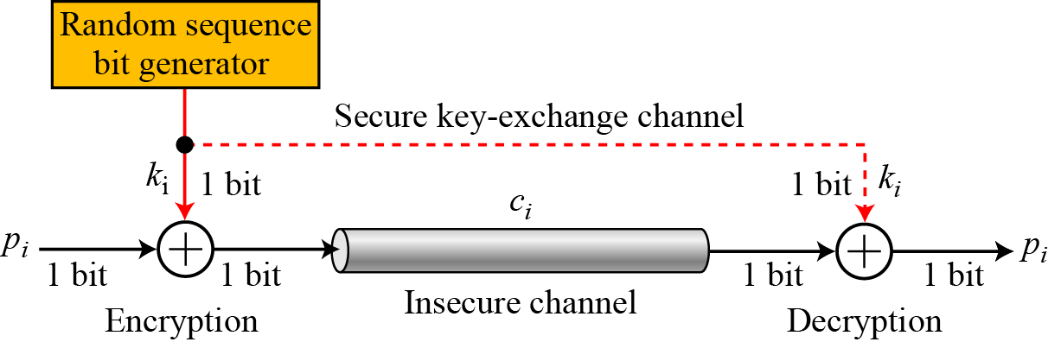
Synchronous Stream Ciphers
In a synchronous stream cipher the key is independent of the plaintext or ciphertext.
One-time pad
5.56

Slide 57
Example
What is the pattern in the ciphertext of a one-time pad cipher in each of the following cases?
a. The plaintext is made of n 0’s.
b. The plaintext is made of n 1’s.
c. The plaintext is made of alternating 0’s and 1’s.
d. The plaintext is a random string of bits.
Solution
Because 0 ⊕ k_{i} = k_{i} , the ciphertext stream is the same as the key stream. If the key stream is random, the ciphertext is also random. The patterns in the plaintext are not preserved in the ciphertext.
5.57

Slide 58
Because 1 ⊕ k_{i} = k_{i} where k_{i} is the complement of k_{i} , the ciphertext stream is the complement of the key stream. If the key stream is random, the ciphertext is also random. Again the patterns in the plaintext are not preserved in the ciphertext.
In this case, each bit in the ciphertext stream is either the same as the corresponding bit in the key stream or the complement of it. Therefore, the result is also a random string if the key stream is random.
In this case, the ciphertext is definitely random because the exclusive-or of two random bits results in a random bit.
5.58

Slide 59
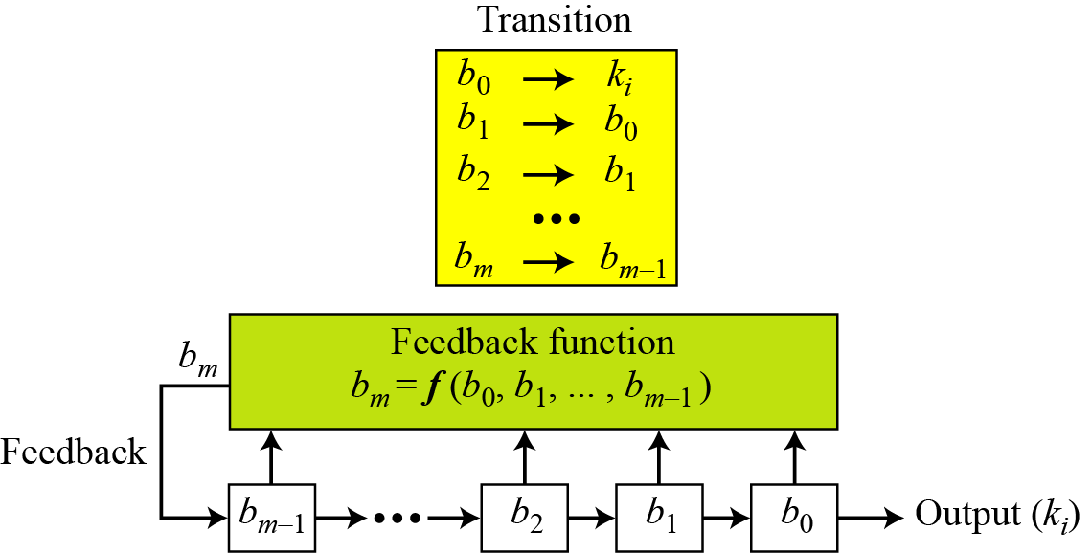
Feedback shift register (FSR)
5.59

Slide 60
Example
Create a linear feedback shift register with 5 cells in which
b₅ = b₄ ⊕ b₂ ⊕ b₀ .
Solution
If c_{i} = 0, b_{i} has no role in calculation of b_{m}. This means that b_{i} is not connected to the feedback function. If c_{i} = 1, b_{i} is involved in calculation of bm. In this example, c1 and c3 are 0’s, which means that we have only three connections. Figure 5.24 shows the design.
5.60

Slide 61
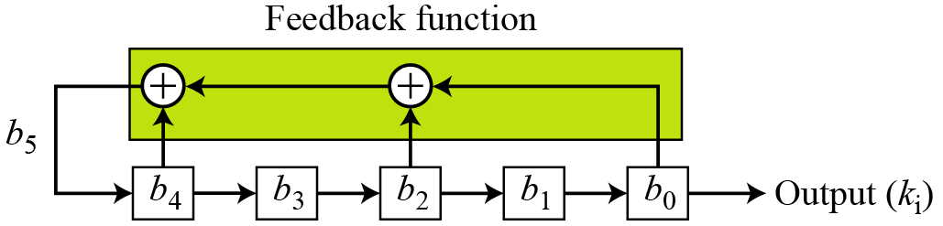
LSFR for Example
5.61

Slide 62
Nonsynchronous Stream Ciphers
In a non synchronous stream cipher, each key in the key stream depends on previous plaintext or ciphertext.
In a non synchronous stream cipher, the key depends on either the plaintext or ciphertext.
5.62

Slide 63
Data Encryption Standard (DES)
The Data Encryption Standard (DES) is a symmetric-key block cipher published by the National Institute of Standards and Technology (NIST).
In 1973, NIST published a request for proposals for a national symmetric-key cryptosystem.
A proposal from IBM, a modification of a project called Lucifer, was accepted as DES.
DES was published in the Federal Register in March 1975 as a draft of the Federal Information Processing Standard (FIPS).

Slide 64
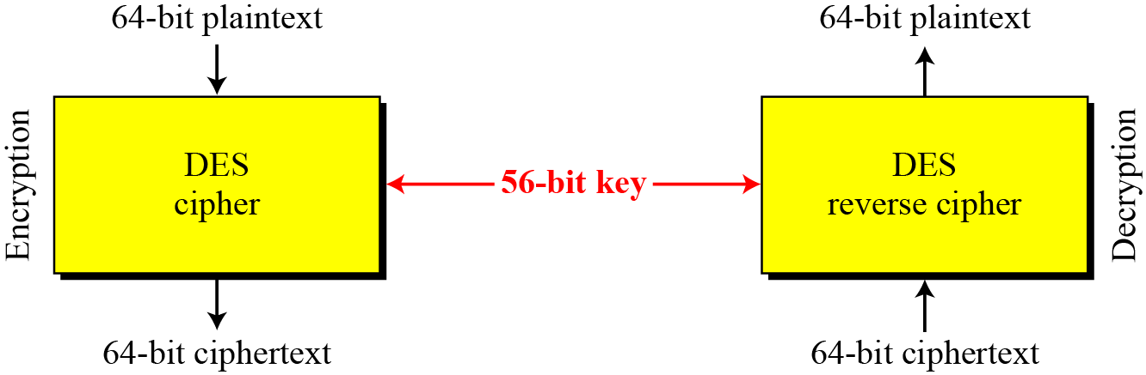
DES is a block cipher, as shown in Fig
Encryption and decryption with DES
6.64

Slide 65
DES STRUCTURE
The encryption process is made of two permutations (P-boxes), which we call initial and final permutations, and sixteen Feistel rounds.
6.65

Slide 66
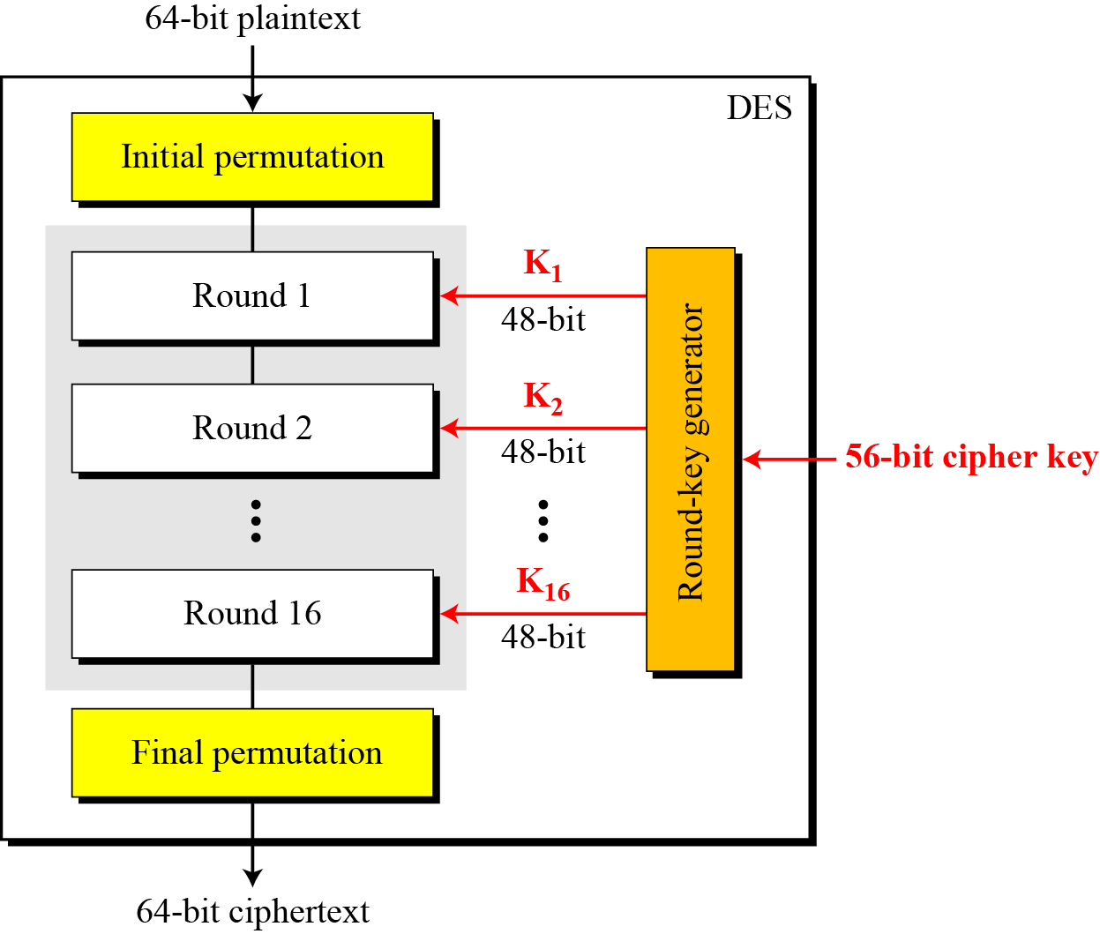
General structure of DES
6.66

Slide 67
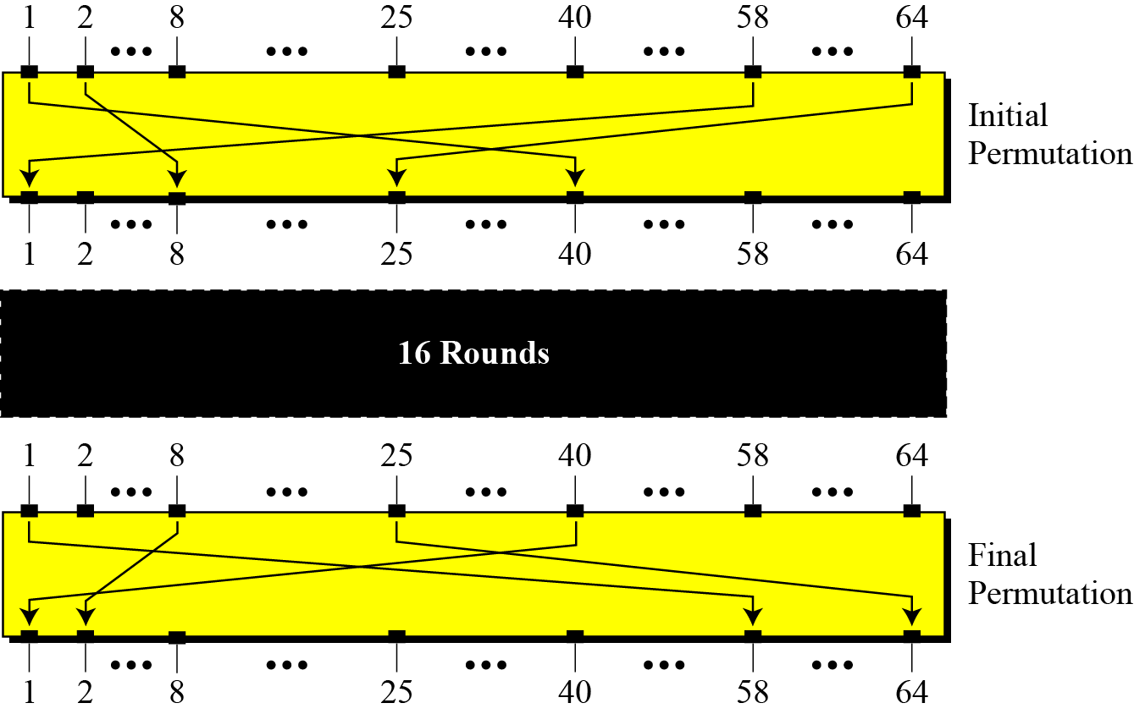
Initial and final permutation steps in DES
6.67

Slide 68
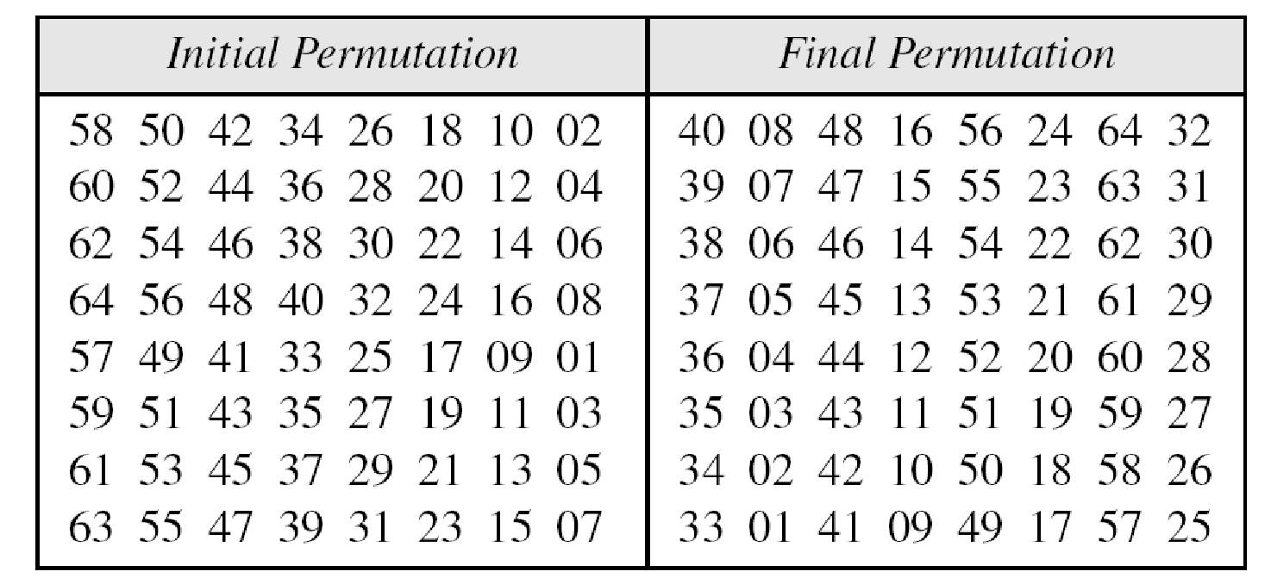
Initial and final permutation tables
6.68

Slide 69
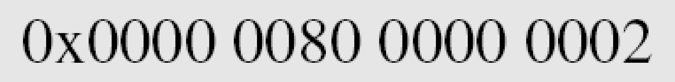
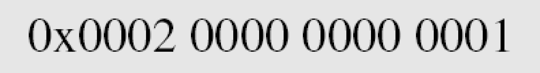
Example
Find the output of the final permutation box when the input is given in hexadecimal as:
Solution
Only bit 25 and bit 63 are 1s; the other bits are 0s. In the final permutation, bit 25 becomes bit 64 and bit 63 becomes bit 15. The result is
6.69

Slide 70
Example
Prove that the initial and final permutations are the inverse of each other by finding the output of the initial permutation if the input is
Solution
The input has only two 1s; the output must also have only two 1s. Using Table 6.1, we can find the output related to these two bits. Bit 15 in the input becomes bit 63 in the output. Bit 64 in the input becomes bit 25 in the output. So the output has only two 1s, bit 25 and bit 63. The result in hexadecimal is
6.70

Slide 71
The initial and final permutations are straight P-boxes that are inverses of each other.
They have no cryptography significance in DES.
6.71

Slide 72
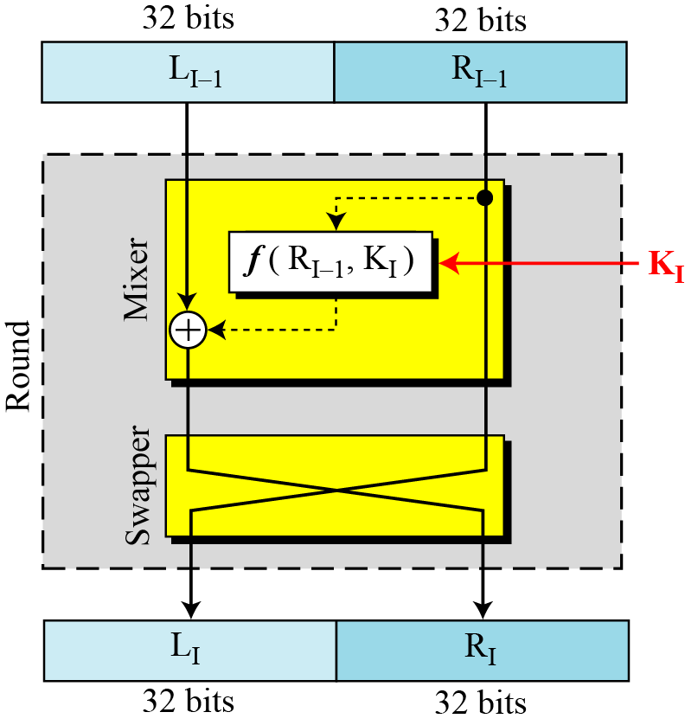
DES uses 16 rounds. Each round of DES is a Feistel cipher.
Figure: A round in DES (encryption site)
6.72

Slide 73
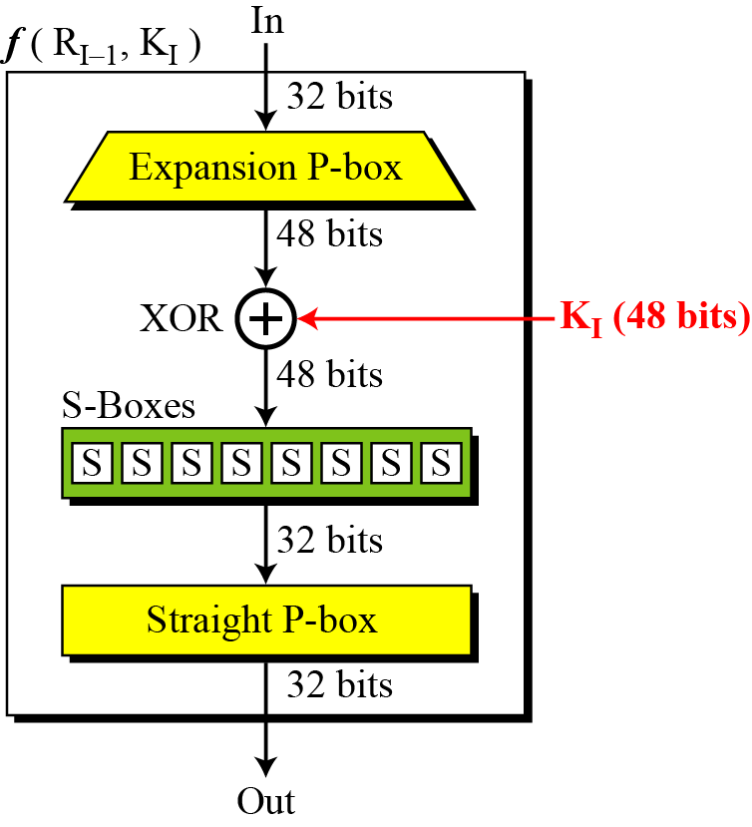
DES Function
The heart of DES is the DES function. The DES function applies a 48-bit key to the rightmost 32 bits to produce a 32-bit output.
Figure :
DES function
6.73

Slide 74
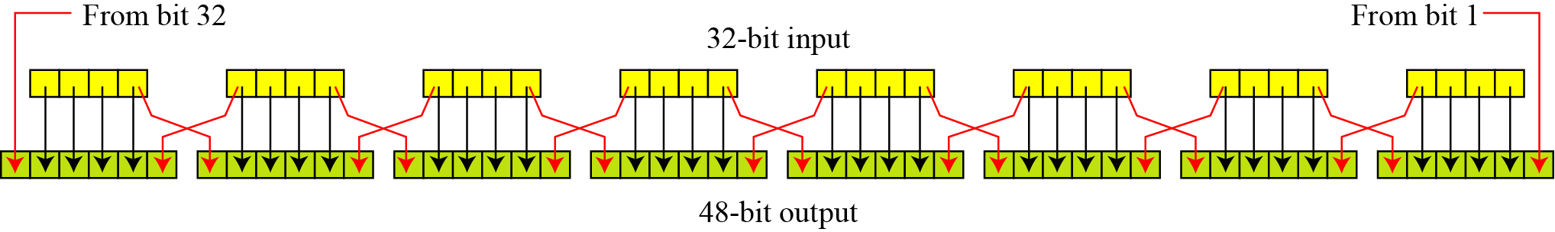
Expansion P-box
Since R_{I−1} is a 32-bit input and K_{I} is a 48-bit key, we first need to expand R_{I−1} to 48 bits.
Expansion permutation
6.74

Slide 75
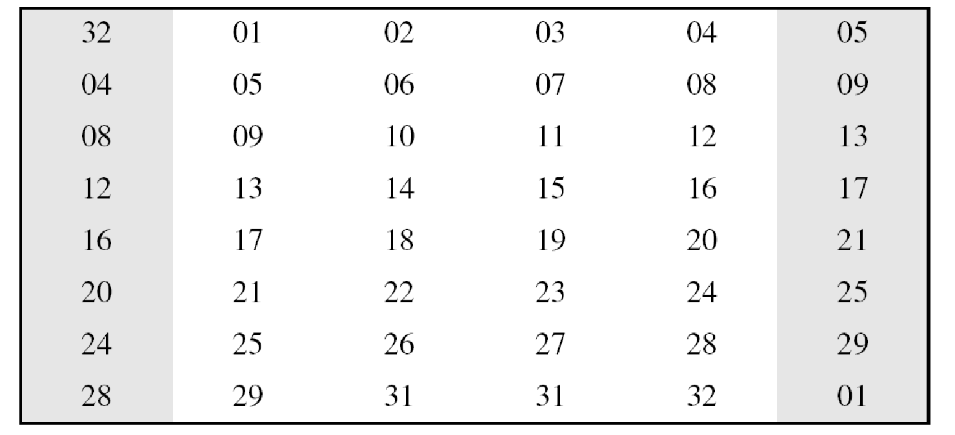
Although the relationship between the input and output can be defined mathematically, DES uses Table 6.2 to define this P-box.
Expansion P-box table
6.75

Slide 76
Whitener (XOR)
After the expansion permutation, DES uses the XOR operation on the expanded right section and the round key. Note that both the right section and the key are 48-bits in length. Also note that the round key is used only in this operation.
6.76

Slide 77
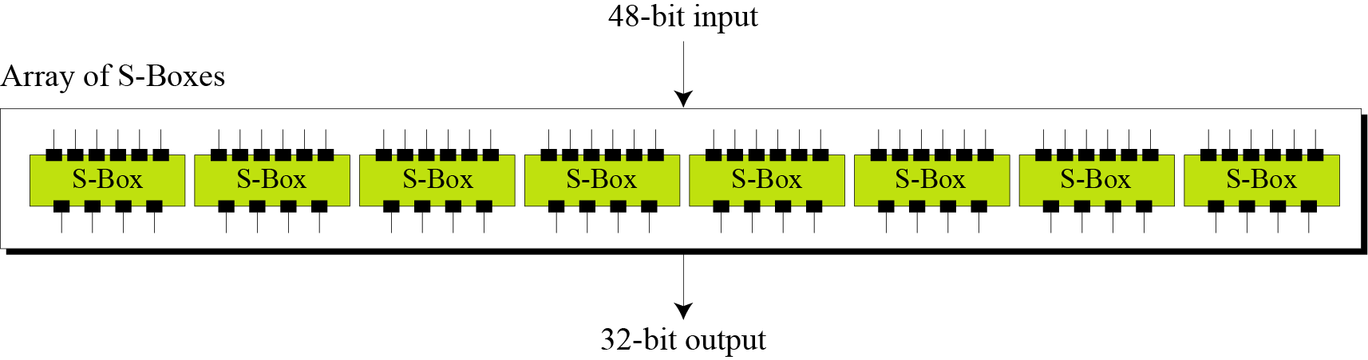
S-Boxes
The S-boxes do the real mixing (confusion). DES uses 8 S-boxes, each with a 6-bit input and a 4-bit output.
S-boxes
6.77

Slide 78
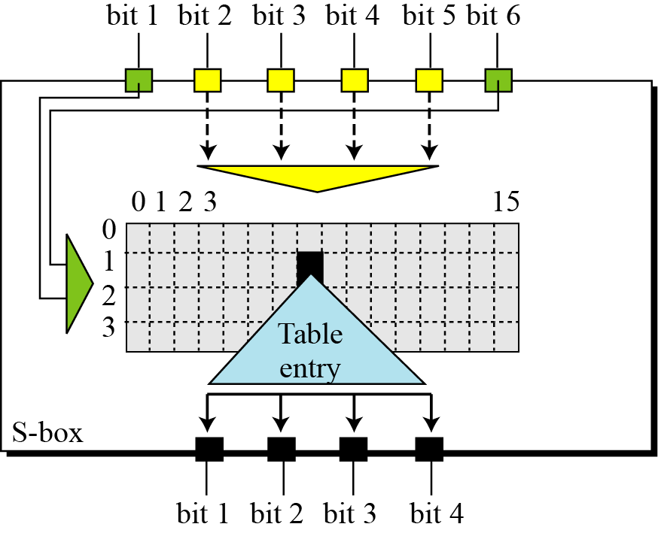
S-box rule
6.78

Slide 79
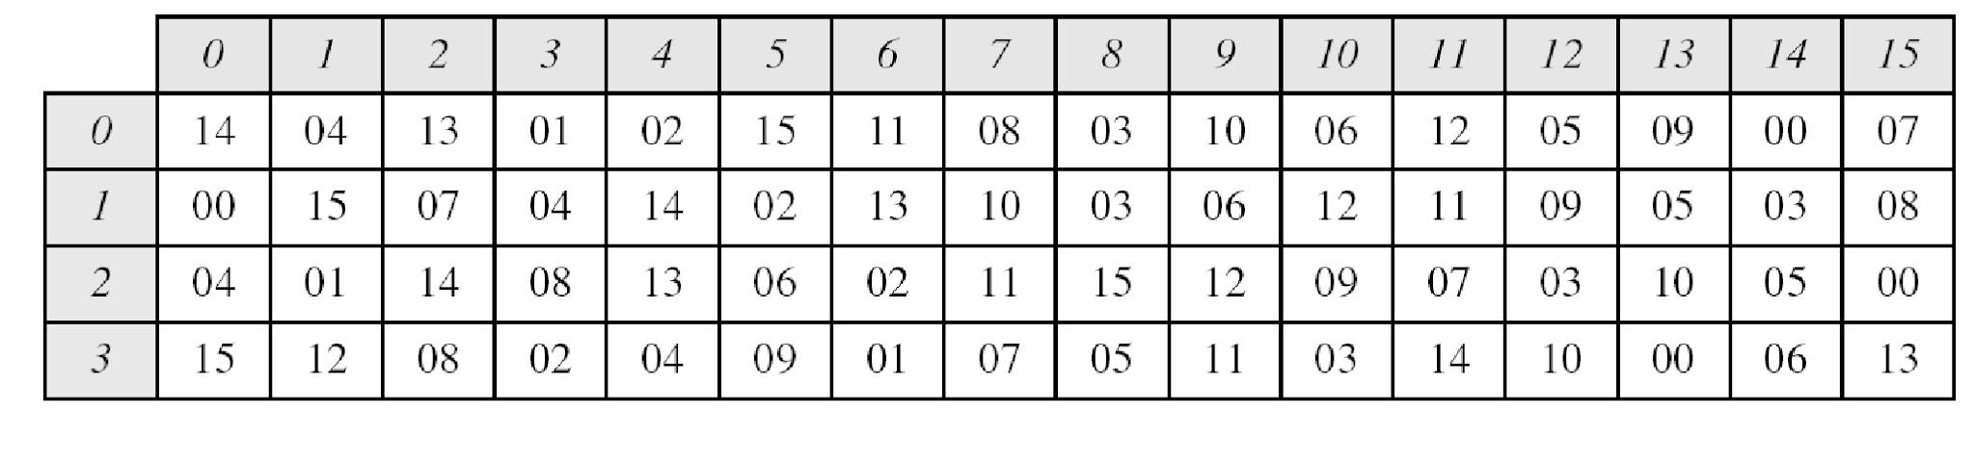
Table shows the permutation for S-box 1. For the rest of the boxes see the textbook.
S-box 1
6.79

Slide 80
Example
The input to S-box 1 is 100011. What is the output?
Solution
If we write the first and the sixth bits together, we get 11 in binary, which is 3 in decimal. The remaining bits are 0001 in binary, which is 1 in decimal. We look for the value in row 3, column 1, in Table 6.3 (S-box 1). The result is 12 in decimal, which in binary is 1100. So the input 100011 yields the output 1100.
6.80

Slide 81
Example
The input to S-box 8 is 000000. What is the output?
Solution
If we write the first and the sixth bits together, we get 00 in binary, which is 0 in decimal. The remaining bits are 0000 in binary, which is 0 in decimal. We look for the value in row 0, column 0, in Table 6.10 (S-box 8). The result is 13 in decimal, which is 1101 in binary. So the input 000000 yields the output 1101.
6.81

Slide 82
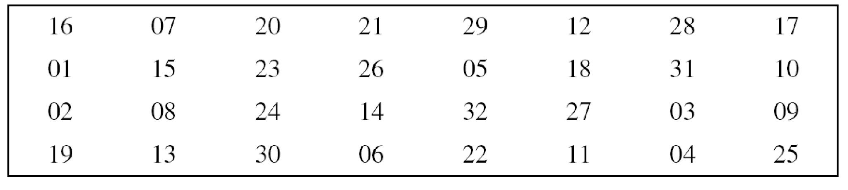
Straight Permutation
Straight permutation table
6.82

Slide 83
Cipher and Reverse Cipher
Using mixers and swappers, we can create the cipher and reverse cipher, each having 16 rounds.
First Approach
To achieve this goal, one approach is to make the last round (round 16) different from the others; it has only a mixer and no swapper.
In the first approach, there is no swapper in the last round.
6.83

Slide 84
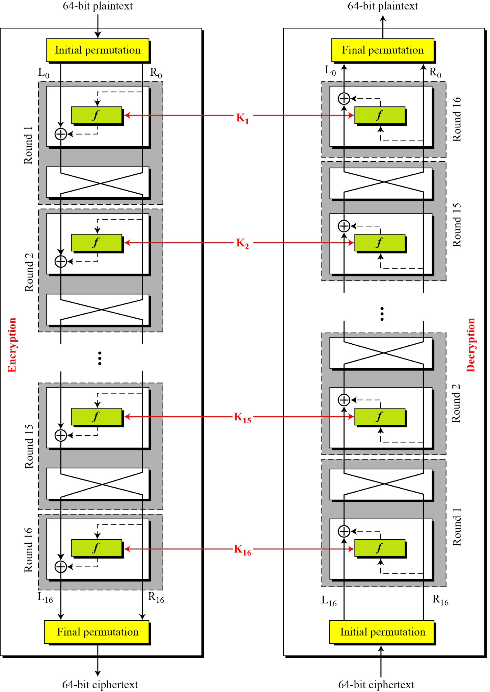
DES cipher and reverse cipher for the first approach
6.84

Slide 85
Alternative Approach
We can make all 16 rounds the same by including one swapper to the 16th round and add an extra swapper after that (two swappers cancel the effect of each other).
Key Generation
The round-key generator creates sixteen 48-bit keys out of a 56-bit cipher key.
6.85

Slide 86
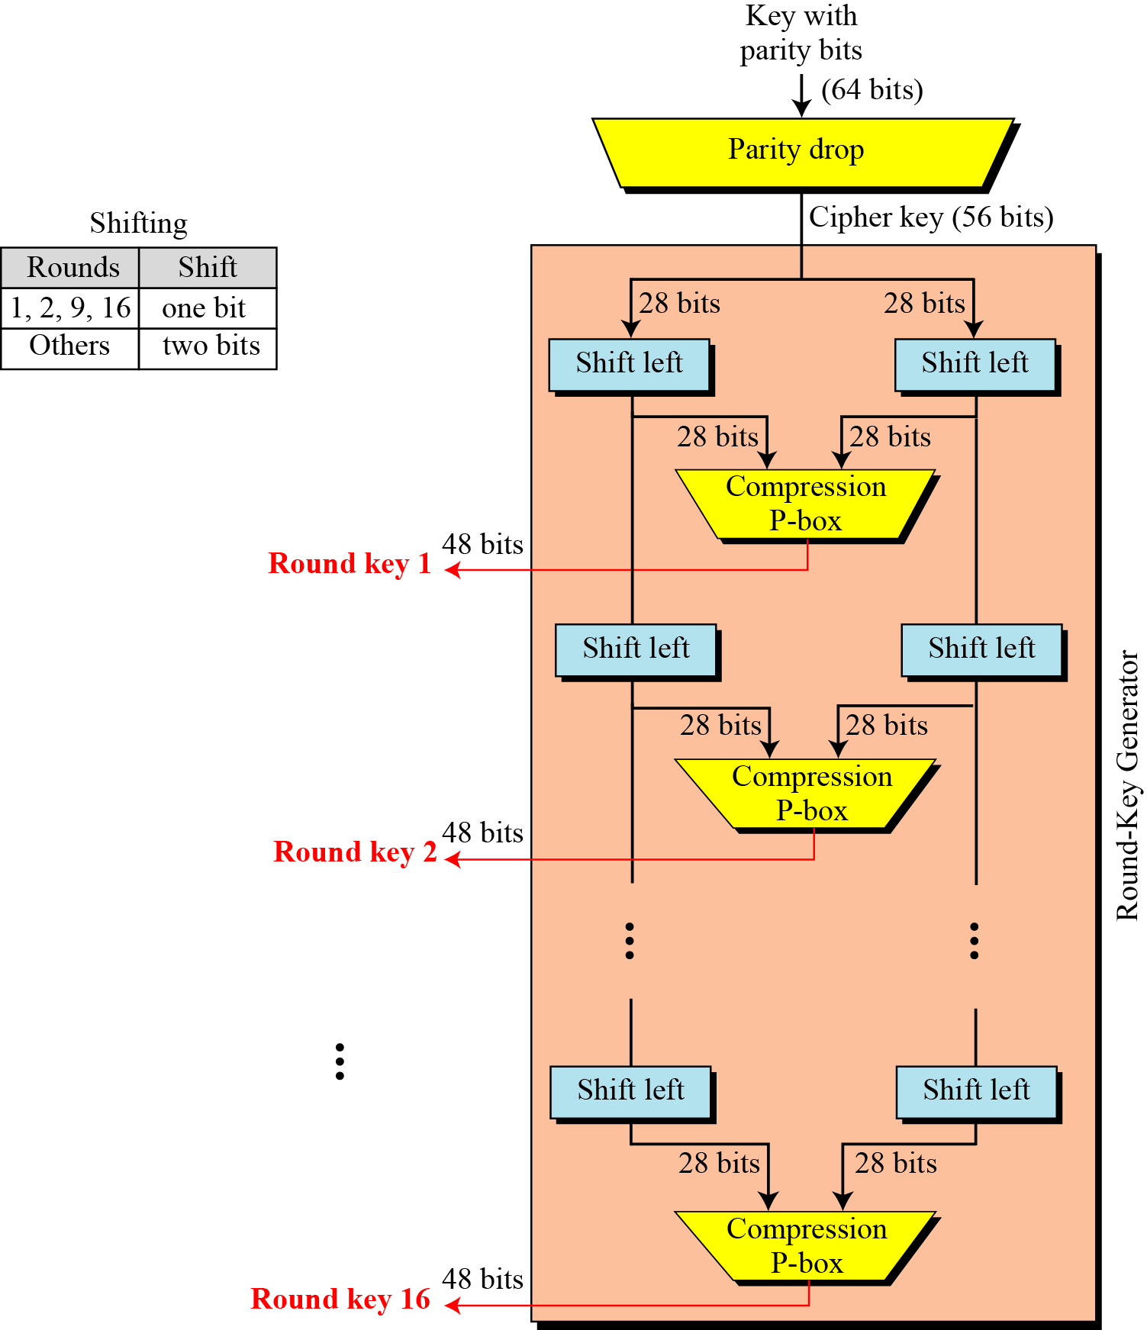
Figure : Key generation
6.86

Slide 87

Table : Parity-bit drop table
Table :Number of bits shifts
6.87

Slide 88

Table : Key-compression table
6.88

Slide 89
Multiple DES
The major criticism of DES regards its key length. Fortunately DES is not a group. This means that we can use double or triple DES to increase the key size.
6.89

Slide 90

A substitution that maps every possible input to every possible output is a group.
Composition of mapping
6.90

Slide 91
Double DES
The first approach is to use double DES (2DES).
Meet-in-the-Middle Attack
However, using a known-plaintext attack called meet-in-the-middle attack proves that double DES improves this vulnerability slightly (to 2⁵⁷ tests), but not tremendously (to 2¹¹²).
6.91

Slide 92

Meet-in-the-middle attack for double DES
6.92

Slide 93

Tables for meet-in-the-middle attack
6.93

Slide 94

Triple DES
Figure 6.16 Triple DES with two keys
6.94

Slide 95
Triple DES with Three Keys
The possibility of known-plaintext attacks on triple DES with two keys has enticed some applications to use triple DES with three keys. Triple DES with three keys is used by many applications such as PGP (See Chapter 16).
6.95

Slide 96
Security of DES
DES, as the first important block cipher, has gone through much scrutiny. Among the attempted attacks, three are of interest: brute-force, differential cryptanalysis, and linear cryptanalysis.
6.96

Slide 97
Brute-Force Attack
We have discussed the weakness of short cipher key in DES. Combining this weakness with the key complement weakness, it is clear that DES can be broken using 2⁵⁵ encryptions.
6.97

Slide 98
Differential Cryptanalysis
It has been revealed that the designers of DES already knew about this type of attack and designed S-boxes and chose 16 as the number of rounds to make DES specifically resistant to this type of attack.
We show an example of DES differential cryptanalysis in Appendix N.
6.98

Slide 99
Linear Cryptanalysis
Linear cryptanalysis is newer than differential cryptanalysis. DES is more vulnerable to linear cryptanalysis than to differential cryptanalysis. S-boxes are not very resistant to linear cryptanalysis. It has been shown that DES can be broken using 2⁴³ pairs of known plaintexts. However, from the practical point of view, finding so many pairs is very unlikely.
We show an example of DES linear cryptanalysis in Appendix N.
6.99

Slide 100
Advanced Encryption Standard (AES)
The Advanced Encryption Standard (AES) is a symmetric-key block cipher published by the National Institute of Standards and Technology (NIST) in December 2001.
The NIST specifications required a block size of 128 bits and three different key sizes of 128, 192, and 256 bits. The specifications also required that AES be an open algorithm, available to the public worldwide.

Slide 101
Criteria
The criteria defined by NIST for selecting AES fall into three areas: security, cost, and
implementation. At the end, Rijndael was judged the best at meeting the combination of
these criteria.
Security
The main emphasis was on security. Because NIST explicitly demanded a 128-bit key, this criterion focused on resistance to cryptanalysis attacks other than brute-force attack.
Cost
The second criterion was cost, which covers the computational efficiency and storage
requirement for different implementations such as hardware, software, or smart cards.
Implementation
This criterion included the requirement that the algorithm must have flexibility (be
implementable on any platform) and simplicity.

Slide 102

Rounds
AES is a non-Feistel cipher that encrypts and decrypts a data block of 128 bits. It uses 10, 12, or 14 rounds.
The key size, which can be 128, 192, or 256 bits, depends on the number of rounds.
Figure shows the general design for the encryption algorithm (called cipher); the decryption algorithm (called inverse cipher) is similar, but the round keys are applied in the reverse order.

Slide 103


Slide 104
In the above figure Nr defines the number of rounds.
The figure also shows the relationship between the number of rounds and the key size, which means that we can have three different AES versions; they are referred as AES-128, AES-192, and AES-256.
However, the round keys, which are created by the key-expansion algorithm are always 128 bits, the same size as the plaintext or ciphertext block.
The number of round keys generated by the key-expansion algorithm is always one more than the number of rounds.
In other words, we have
Number of round keys = Nr + 1
We refer to the round keys as K0, K1, K2, ..., KNr

Slide 105
Data Units
AES uses five units of measurement to refer to data: bits, bytes, words, blocks, and state.
The bit is the smallest and atomic unit; other units can be expressed in terms of smaller ones.

Slide 106


Slide 107
Bit
In AES, a bit is a binary digit with a value of 0 or 1. We use a lowercase letter to refer to a bit. Byte A byte is a group of eight bits that can be treated as a single entity, a row matrix (1 × 8) of eight bits, or a column matrix (8 × 1) of eight bits. When treated as a row matrix, the bits are inserted to the matrix from left to right; when treated as a column matrix, the bits are inserted into the matrix from top to bottom. We use a lowercase bold letter to refer to a byte.
Word
A word is a group of 32 bits that can be treated as a single entity, a row matrix of four bytes, or a column matrix of four bytes. When it is treated as a row matrix, the bytes are inserted into the matrix from left to right; when it is considered as a column matrix, the bytes are inserted into the matrix from top to bottom. We use the lowercase bold letter w to show a word.

Slide 108
Block
AES encrypts and decrypts data blocks. A block in AES is a group of 128 bits. However, a block can be represented as a row matrix of 16 bytes.
State
AES uses several rounds in which each round is made of several stages. Data block is transformed from one stage to another. At the beginning and end of the cipher, AES uses the term data block; before and after each stage, the data block is referred to as a state. We use an uppercase bold letter to refer to a state. Although the states in different stages are normally called S, we occasionally use the letter T to refer to a temporary state. States, like blocks, are made of 16 bytes, but normally are treated as matrices of 4 × 4 bytes. In this case, each element of a state is referred to as sr,c, where r (0 to 3) defines the row and the c (0 to 3) defines the column. Occasionally,
a state is treated as a row matrix (1 × 4) of words.

Slide 109


Slide 110


Slide 111


Slide 112
TRANSFORMATIONS
To provide security, AES uses four types of transformations:
Substitution,
permutation,
mixing,
and key-adding.

Slide 113
Substitution
AES, like DES, uses substitution.
However, the mechanism is different.
First, the substitution is done for each byte.
Second, only one table is used for transformation of every byte, which means that if two bytes are the same, the transformation is also the same.
Third, the transformation is defined by either a table lookup process or mathematical calculation in the GF(28) field.
AES uses two invertible transformations.

Slide 114
SubBytes
The first transformation, SubBytes, is used at the encryption site. To substitute a byte, we interpret the byte as two hexadecimal digits. The left digit defines the row and the right digit defines the column of the substitution table. The two hexadecimal digits at the junction of the row and the column are the new byte. Figure 7.6 shows the idea.

Slide 115


Slide 116
Permutation
Another transformation found in a round is shifting, which permutes the bytes. Unlike DES, in which permutation is done at the bit level, shifting transformation in AES is done at the byte level; the order of the bits in the byte is not changed.
ShiftRows In the encryption, the transformation is called ShiftRows and the shifting is to the left.The number of shifts depends on the row number (0, 1, 2, or 3) of the state matrix. This means the row 0 is not shifted at all and the last row is shifted three bytes.

Slide 117


Slide 118
InvShiftRows
In the decryption, the transformation is called InvShiftRows and the shifting is to the right. The number of shifts is the same as the row number (0, 1, 2, and 3) of the state matrix.

Slide 119
Mixing
SubBytes is an intrabyte transformation.
ShiftRows is a byte-exchange transformation.
We also need an interbyte transformation that changes the bits inside a byte, based on the bits inside the neighboring bytes. We need to mix bytes to provide diffusion at the bit level.
The mixing transformation changes the contents of each byte by taking four bytes at a time and combining them to recreate four new bytes.

Slide 120

To guarantee that each new byte is different (even if all four bytes are the same), the combination process first multiplies each byte with a different constant and then mixes them.
The mixing can be provided by matrix multiplication.

Slide 121


Slide 122
MixColumns
The MixColumns transformation operates at the column level; it transforms each column of the state to a new column. The transformation is actually the matrix multiplication of a state column by a constant square matrix.
InvMixColumns
The InvMixColumns transformation is basically the same as the MixColumns transformation. If the two constant matrices are inverses of each other, it is easy to prove that the two transformations are inverses of each other.

Slide 123


Slide 124
Key Adding
The most important transformation is the one that includes the cipher key. All previous transformations use known algorithms that are invertible.
If the cipher key is not added to the state at each round, it is very easy for the adversary to find the plaintext, given the ciphertext.
The cipher key is the only secret between Alice and Bob in this case.
AES uses a process called key expansion that creates Nr +1 round keys from the cipher key.
Each round key is 128 bits long it is treated as four 32-bit words.
For the purpose of adding the key to the state, each word is considered as a column matrix.

Slide 125
AddRoundKey
AddRoundKey also proceeds one column at a time.
MixColumns multiplies a constant square matrix by each state column; AddRoundKey adds a round key word with each state column matrix.
The operation in MixColumns is matrix multiplication; the operation in AddRoundKey is matrix addition.
Since addition and subtraction in this field are the same, the AddRoundKey transformation is the inverse of itself.

Slide 126


Slide 127
ANALYSIS OF AES
Security
AES was designed after DES. Most of the known attacks on DES were already tested on AES; none of them has broken the security of AES so far.
Brute-Force Attack
AES is definitely more secure than DES due to the larger-size key (128, 192, and 256 bits). Let us compare DES with 56-bit cipher key and AES with 128-bit cipher key.
For DES we need 256 tests to find the key; for AES we need 2128 tests to find the key. This means that if we can break DES in t seconds, we need (272 × t) seconds to break AES. This would be almost impossible. In addition, AES provides two other versions with longer cipher keys. The lack of weak keys is another advantage of AES over DES.

Slide 128
Statistical Attacks
The strong diffusion and confusion provided by the combination of the SubBytes, ShiftRows, and MixColumns transformations removes any frequency pattern in the plaintext. Numerous tests have failed to do statistical analysis of the ciphertext.
Differential and Linear Attacks
AES was designed after DES. Differential and linear cryptanalysis attacks were no doubt taken into consideration. There are no differential and linear attacks on AES as yet.

Slide 129
Implementation
AES can be implemented in software, hardware, and firmware. The implementation can use table lookup process or routines that use a well-defined algebraic structure. The transformation can be either byte-oriented or word-oriented. In the byte-oriented version, the whole algorithm can use an 8-bit processor; in the word-oriented version, it can use a 32-bit processor. In either case, the design of constants makes processing
very fast.
Simplicity and Cost
The algorithms used in AES are so simple that they can be easily implemented using cheap processors and a minimum amount of memory.

Slide 130
Diffi Hellman key exchange algorithm
In the Diffie-Hellman protocol two parties create a symmetric session key without the need of a KDC.
Before establishing a symmetric key, the two parties need to choose two numbers p and g.
The first number, p, is a large prime number on the order of 300 decimal digits (1024 bits).
The second number, g, is a generator of order p − 1 in the group <Zp*, ×>.
These two (group and generator) do not need to be confidential. They can be sent through the Internet; they can be public.

Slide 131
The steps are as follows:
1. Alice chooses a large random number x such that 0 ≤ x ≤ p − 1 and calculates
R₁ = g^{x} mod p.
2. Bob chooses another large random number y such that 0 ≤ y ≤ p − 1 and calculates R₂ = g^{y} mod p.
3. Alice sends R₁ to Bob. Note that Alice does not send the value of x; she sends only R₁.
4. Bob sends R₂ to Alice. Again, note that Bob does not send the value of y, he sends only R₂.
5. Alice calculates K = (R₂)^{x} mod p.
6. Bob also calculates K = (R₁)^{y} mod p.

Slide 132


Slide 133


Slide 134


Slide 135


Slide 136


Slide 137
RSA: asymmetric key cryptography
The most common public-key algorithm is the RSA cryptosystem, named for its inventors (Rivest, Shamir, and Adleman).
RSA uses two exponents, e and d, where e is public and d is private. Suppose P is the plaintext and C is the ciphertext.
Alice uses C = P^{e} mod n to create ciphertext C from plaintext P;
Bob uses P = C^{d} mod n to retrieve the plaintext sent by Alice.
The modulus n, a very large number, is created during the key generation process.

Slide 138
This means that Alice can encrypt in polynomial time (e is public), Bob also can decrypt in polynomial time (because he knows d), but Eve cannot decrypt because she would have to calculate the eth root of C using modular arithmetic.
In other words, Alice uses a one-way function (modular exponentiation) with a trapdoor known only to Bob. Eve, who does not know the trapdoor, cannot decrypt the message. If some day, a polynomial algorithm for eth root modulo n calculation is found, modular exponentiation is not a one-way function any more.

Slide 139


Slide 140

Procedure

Slide 141


Slide 142
Encryption
Anyone can send a message to Bob using his public key. Encryption in RSA can be done using an algorithm with polynomial time complexity, as shown in Algorithm 10.3. The fast exponentiation algorithm was discussed in Chapter 9. The size of the plaintext must be less than n, which means that if the size of the plaintext is larger than n, it should be divided into blocks.

Slide 143


Slide 144
Decryption
Bob can use Algorithm 10.4 to decrypt the ciphertext message he received. Decryption in RSA can be done using an algorithm with polynomial time complexity. The size of the ciphertext is less than n.

Slide 145


Slide 146


Slide 147


Slide 148


Slide 149


